Slide 1
Linear Time Invariant (LTI) System
IT 3105: Signals & Systems

Slide 2


Introduction
When any system has the both the attributes of linearity and time variance. The system is composed of two systems:
Linear System
Time invariant System
Linear + Time Inariant System
$$x\left(t\right)=δ\left(t\right)$$
or
$$x\left[n\right]=δ\left[n\right]$$
LTI System
$$y\left(t\right)=h\left(t\right)$$
or
$$y\left[n\right]=h\left[n\right]$$
Impulse response
Follows the principles of superposition: LOA & LOH
Any delay in input is reflected in output

Slide 3
System Representation
Time domain representation of the LTI systems in four different ways:
Unit Impulse signal is applied at time, t = 0 or n = 0.
For DT system we apply the impulse function δ[n].
For CT system we apply a pulse of high amplitude with a very short duration.
The output must be a weighted superposition of time shifted impulse response as
Convolutional sum for DT system
Convolutional integral for CT system
Linear constant coefficient differential or difference equation:
Differential equation for CT system
Difference equation for DT system
Block diagram represents systems of interconnection of three elementary operations:
Scalar multiplication
Addition
Time shifting for DT systems and integration for CT systems
In state-variable representation, a series of coupled first order differential and difference equations that represent the systems ‘state’ and an equation to relate that state with output.
“State” is the set of variable s associated with energy storage or memory devices in the system

Slide 4
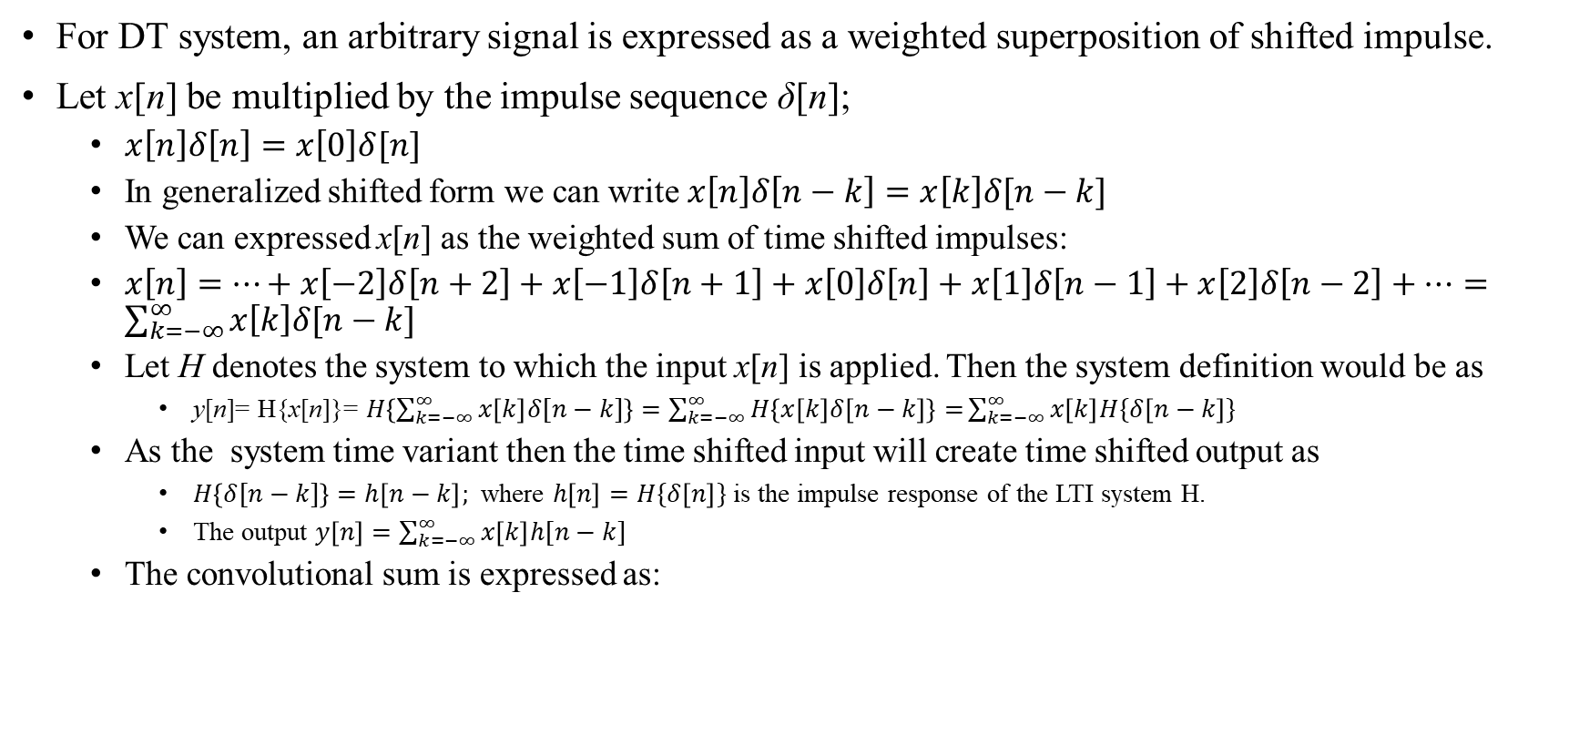
The Convolution Sum
For DT system, an arbitrary signal is expressed as a weighted superposition of shifted impulse.
Let x[n] be multiplied by the impulse sequence δ[n];
$x\left[n\right]δ\left[n\right]=x\left[0\right]δ[n]$
In generalized shifted form we can write $x\left[n\right]δ\left[n−k\right]=x\left[k\right]δ[n−k]$
We can expressed x[n] as the weighted sum of time shifted impulses:
$x\left[n\right]=…+x\left[−2\right]δ\left[n+2\right]+x\left[−1\right]δ\left[n+1\right]+x\left[0\right]δ\left[n\right]+x\left[1\right]δ\left[n−1\right]+x\left[2\right]δ\left[n−2\right]+…=\sum_{k=−∞}^{∞}{x\left[k\right]δ[n−k]}$
Let H denotes the system to which the input x[n] is applied. Then the system definition would be as
y[n]= H{x[n]}= $H\left\{\sum_{k=−∞}^{∞}{x\left[k\right]δ[n−k]}\right\}=\sum_{k=−∞}^{∞}{H\left\{x\left[k\right]δ\left[n−k\right]\right\}=}\sum_{k=−∞}^{∞}{x\left[k\right]H\{δ\left[n−k\right]\}}$
As the system time variant then the time shifted input will create time shifted output as
$H\left\{δ[n−k]\right\}=h\left[n−k\right];$ where $h\left[n\right]=H\{δ\left[n\right]\}$ is the impulse response of the LTI system H.
The output $y\left[n\right]=\sum_{k=−∞}^{∞}{x\left[k\right]h[n−k]}$
The convolutional sum is expressed as:

Slide 5
LTI Systems and Impulse Response
Any continuous/discrete-time LTI system is completely described by its impulse response through the convolution:
This only holds for LTI systems as follows:
Example: The discrete-time impulse response
Is completely described by the following LTI
However, the following systems also have the same impulse response
Therefore, if the system is non-linear, it is not completely characterised by the impulse response

Slide 6
Commutative Property
Convolution is a commutative operator (in both discrete and continuous time), i.e.:
For example, in discrete-time:
Similar expression can be written for continuous time.
Therefore, when calculating the response of a system to an input signal x[n], we can imagine the signal being convolved with the unit impulse response h[n], or vice versa.

Slide 7
Distributive Property (Parallel Systems)
Another property of convolution is the distributive property, which can be easily verified.
Consider the two systems shown below are equivalent:
The convolved sum of two impulse responses is equivalent to considering the two equivalent parallel system (equivalent for discrete-time systems)
y₁(t)
h₁(t)
x(t)
y(t)
x(t)
y(t)
+
h₁(t)+h₂(t)
h₂(t)
y₂(t)

Slide 8
Associative Property (Serial Systems)
Another property of (LTI) convolution is that it is associative
Again this can be easily verified by manipulating the summation/integral indices
Therefore, the following four systems are all equivalent and y[n] = x[n]*h₁[n]*h₂[n] is unambiguously defined.
This is not true for non-linear systems (y₁[n] = 2x[n], y₂[n] = x²[n])
x(t)
w(t)
y(t)
x(t)
y(t)
h₁(t)
h₂(t)
h₁(t)*h₂(t)
x(t)
v(t)
y(t)
x(t)
y(t)
h₂(t)
h₁(t)
h₂(t)*h₁(t)

Slide 9
LTI System Memory
An LTI system is memoryless if its output depends only on the input value at the same time, i.e.
For an impulse response, this can only be true if
Such systems are extremely simple and the output of dynamic engineering, physical systems depend on:
Preceding values of x[n-1], x[n-2], …
Past values of y[n-1], y[n-2], …
for discrete-time systems, or derivative terms for continuous-time systems

Slide 10
System Invertibility
Does there exist a system with impulse response h₁(t) such that y(t)=x(t)?
Widely used concept for:
Control of physical systems, where the aim is to calculate a control signal such that the system behaves as specified
filtering out noise from communication systems, where the aim is to recover the original signal x(t)
The aim is to calculate “inverse systems” such that
The resulting serial system is therefore memoryless
x(t)
w(t)
y(t)
h(t)
h₁(t)

Slide 11
Causality for LTI Systems
Remember, a causal system only depends on present and past values of the input signal. We do not use knowledge about future information.
For a discrete LTI system, convolution tells us that; h[n] = 0 for n<0. Where y[n] must not depend on x[k] for k>n, as the impulse response must be zero before the pulse!
This is strongly related to inverse systems as we generally require our inverse system to be causal. If it is not causal, it is difficult to manufacture!

Slide 12
LTI System Stability
Remember: A system is stable if every bounded input produces a bounded output
Therefore, consider a bounded input signal; |x[n]| < B for all n
Applying convolution and taking the absolute value:
Using the triangle inequality (magnitude of a sum of a set of numbers is no larger than the sum of the magnitude of the numbers):
Therefore a DT LTI system is stable if and only if its impulse response is absolutely summable, ie

Slide 13
Differential and Difference Equations
Two extremely important classes of causal LTI systems:
CT systems whose input-output response is described by linear, constant-coefficient, ordinary differential equations with a forced response
DT systems whose input-output response is described by linear, constant-coefficient, difference equations
Note that to “solve” these equations for y(t) or y[n], we need to know the initial conditions
Examine such systems and relate them to the system properties just described
RC circuit with: y(t) = v_{c}(t), x(t) = v_{s}(t), a = b = 1/RC.
Simple bank account with: a = -1.01, b = 1.

Slide 14
Discrete-Time Difference Equations
A general N^{th}-order LTI difference equation is
If the equation involves difference operators on y[n] (N>0) or x[n], it has memory.
The system stability depends on the coefficients a_{k}. For example, a 1st order LTI difference equation with a₀=1:
If a₁>1, the system is unstable as its impulse response represents a growing power function of time
If a₁ <1 the system is stable as its impulse response corresponds to a decaying power function of time

Slide 15
Reference
Chapter 2: “Linear Time-Invariant Systems”; Wei P. Hsu , “SCHAUM'S OUTLINES OF Theory and Problems of Signals and Systems”.
Chapter 2: “Time domain representation of LTI systems”; Simon Hykin, B.V. Veen, “Signals and systems”, 2nd Edition.

